Slide 1
Wailupe Stream Emergency Repairs
City and County of Honolulu

Slide 2
Introductions

Slide 3
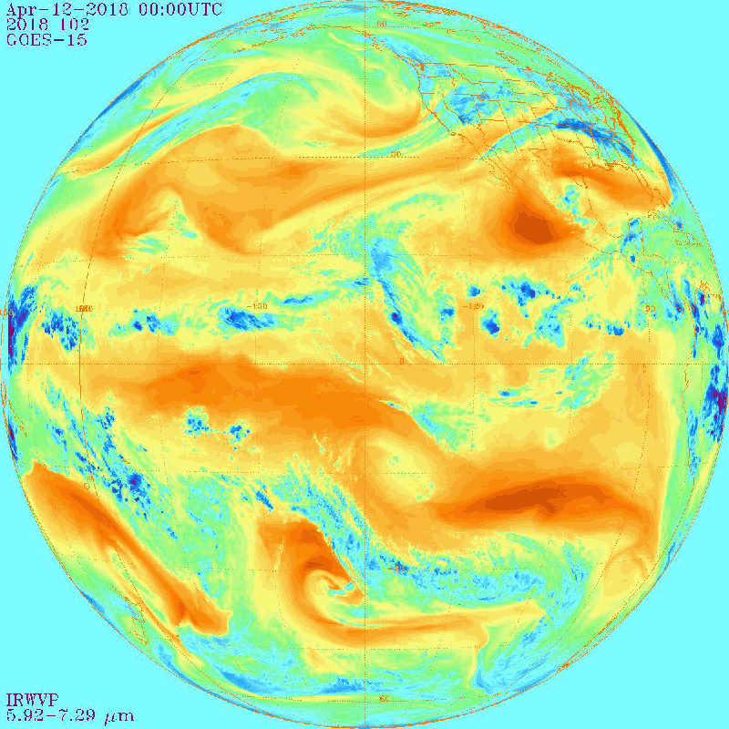
April 13, 2018 Storm Event
The event started as a highly localized but intense event over east Oahu during the early nighttime hours of April 13, 2018.

Slide 4
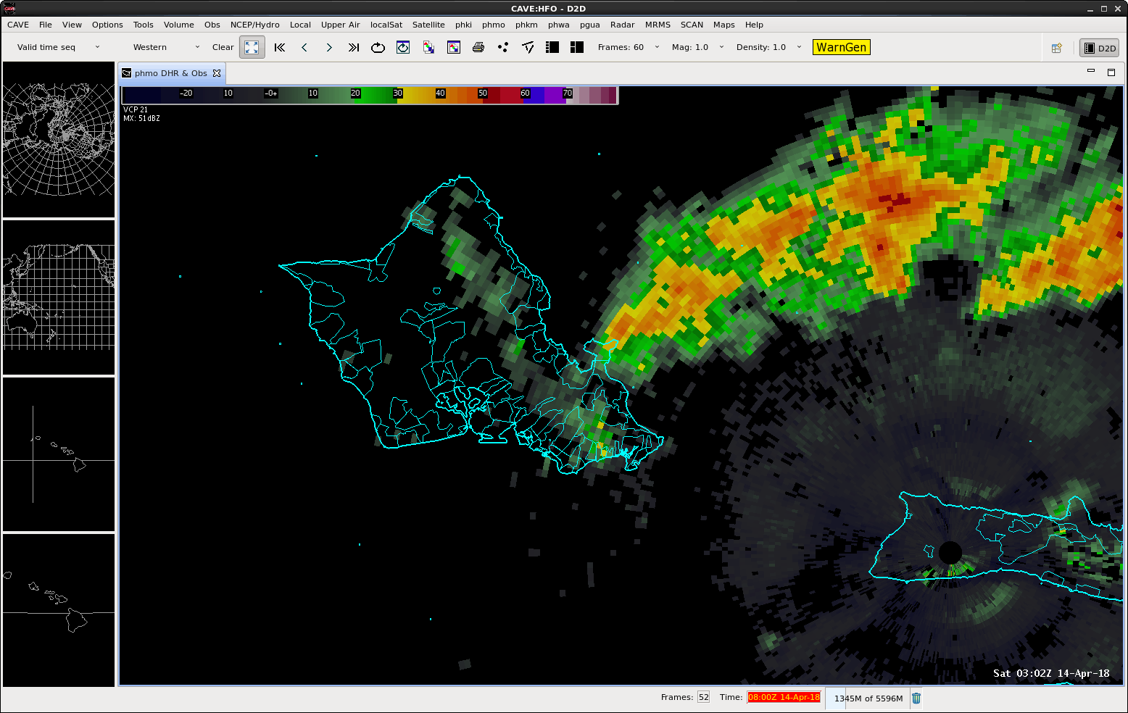
The following radar loop shows the main portion of the 2018 storm event over Oahu. Prior to making landfall, the upper system appears to have merged with a system streaming off of northwest Molokai and intensified. The area of intense rainfall with rates greater than 4 inches per hour moved across east Oahu between 7:00 PM and 9:00 PM HST on April 13. Although the affected area was localized, the intensity of the rainfall produced tremendous amounts of runoff which produced substantial damage to communities from Maunawili to Waimanalo over the windward slopes of the Koolau Range, and from Aina Haina to Hawaii Kai along the leeward slopes.

Slide 5
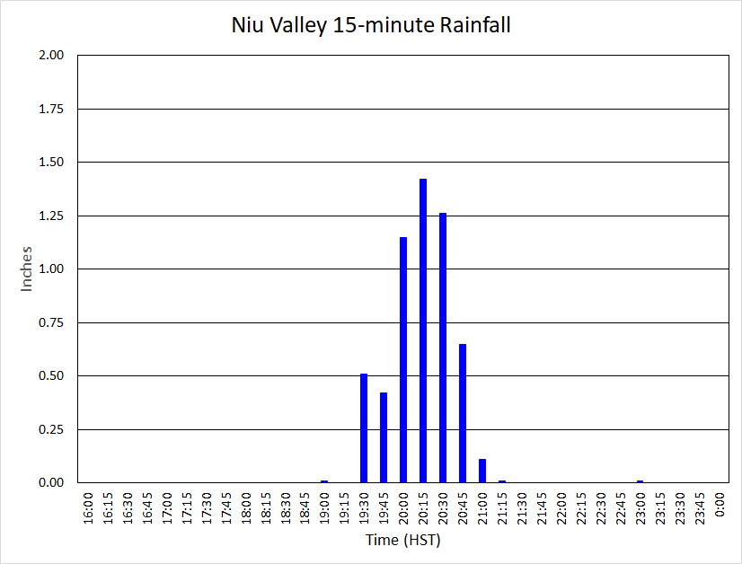
A bar graph of 15-minute rainfall data from the automated rain gage in Niu Valley shows how intense and short-lived the event was over the area. The peak 15-minute rainfall total of 1.42 inches (or an extrapolated hourly rate of 5.68 inches per hour) occurred from 8:00 to 8:15 PM. The same gage recorded 5.52 inches over the two-hour period from 7:00 to 9:00 PM, which encompassed most of the event. According to National Oceanic and Atmospheric Administration’s Atlas 14, these totals have annual probabilities of 4 to 10 percent (for the 15-minute total) and 0.5 to 1 percent (for the two-hour total). A peak streamflow gage at Wailupe Gulch registered a water level increase of over 8 feet.

Slide 6
Impacts Along Wailupe Stream After April 13, 2018 Storm Event
Between Hind Drive Bridge and Ani St. Bridge
Between Ani St. Bridge and Debris Basin

Slide 7
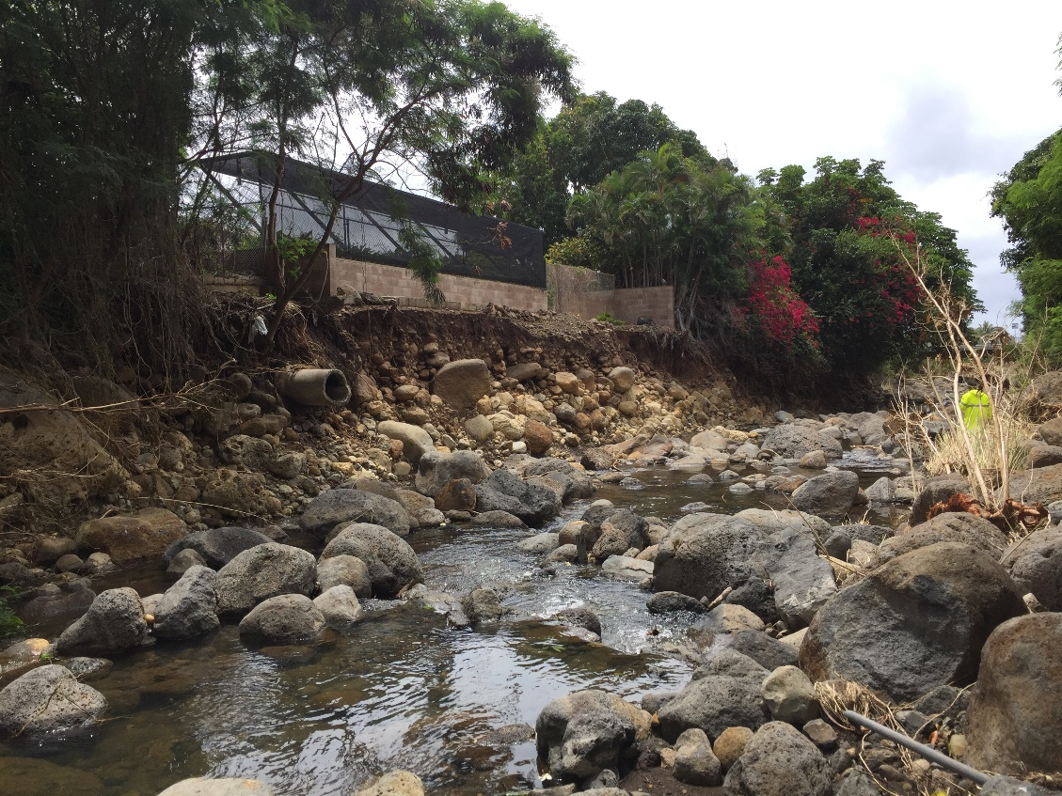
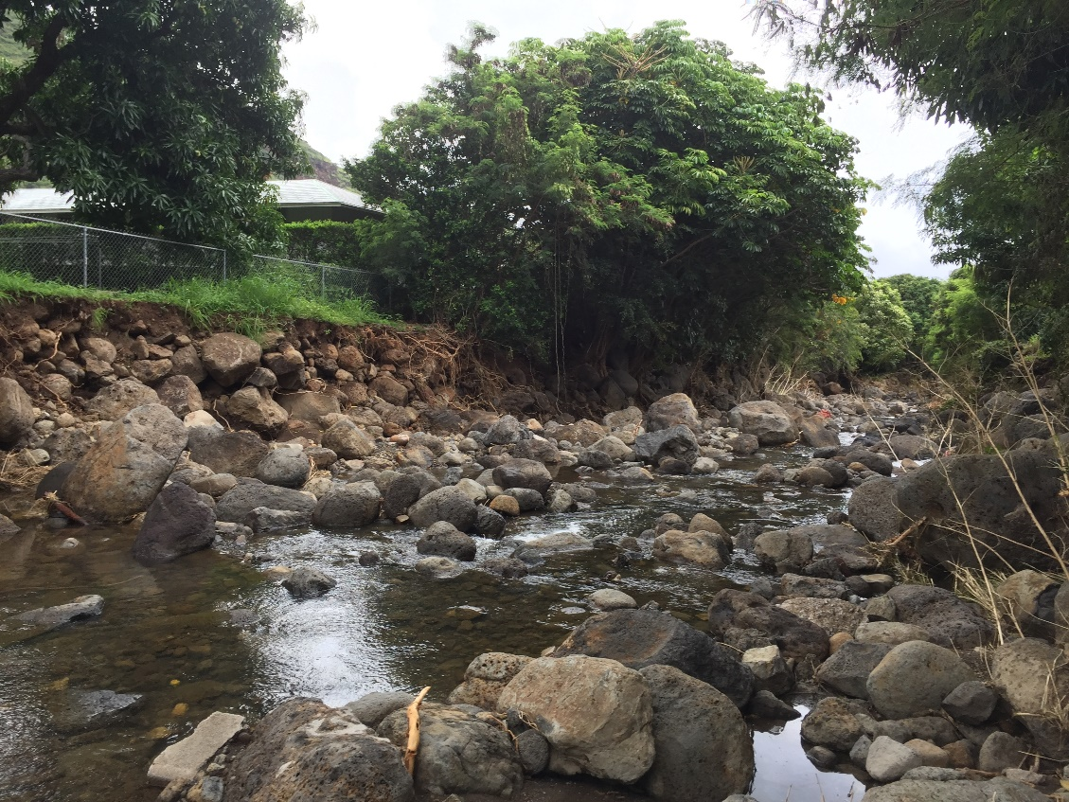
Between Hind Drive Bridge and Ani St. Bridge – After Storm
Looking downstream 4-5 properties upstream of Hind Dr. Bridge
Looking downstream 7-8 properties upstream of Hind Dr. Bridge

Slide 8
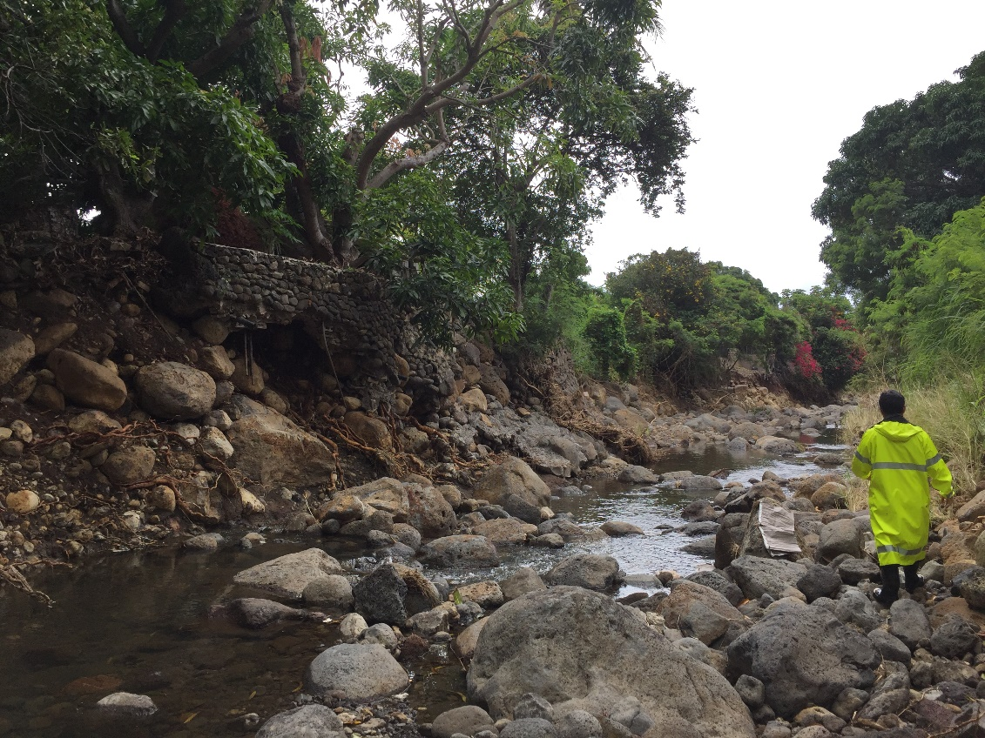
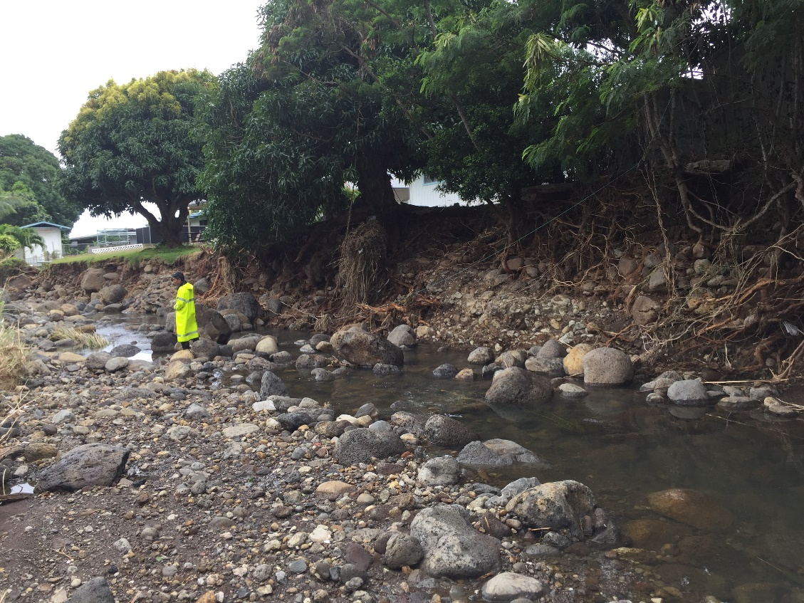
Between Hind Drive Bridge and Ani St. Bridge – After Storm
Looking downstream, 9-10 properties upstream of Hind Dr. Bridge
Looking downstream, near the bend at Kiholo-Piikii St.

Slide 9
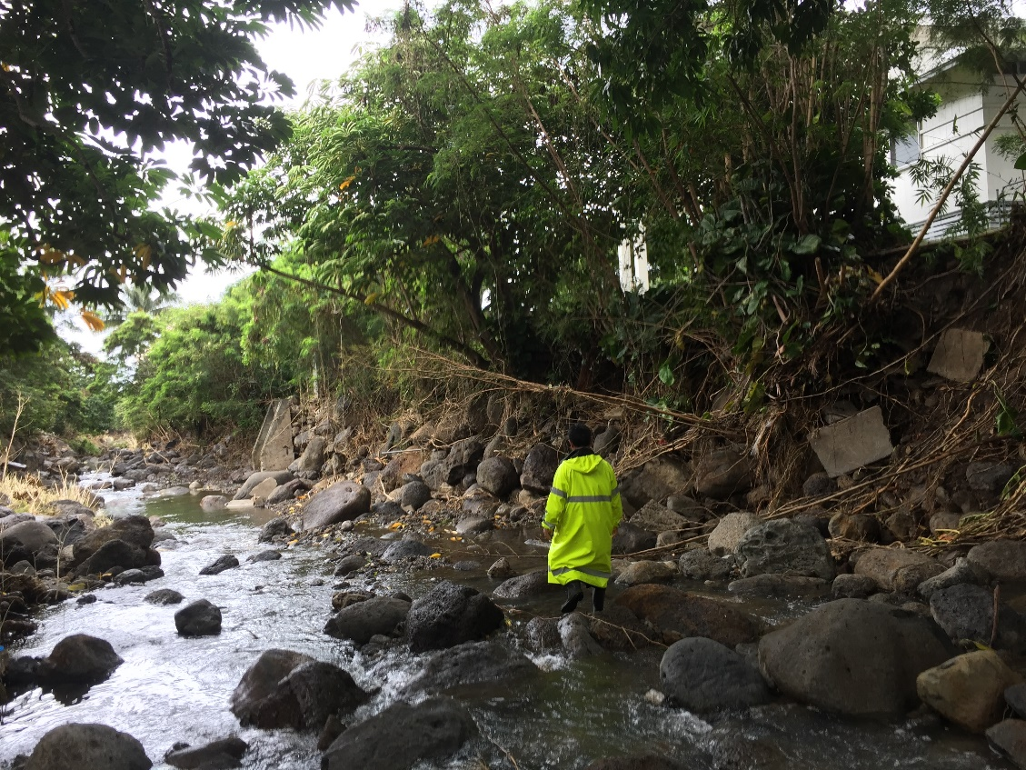
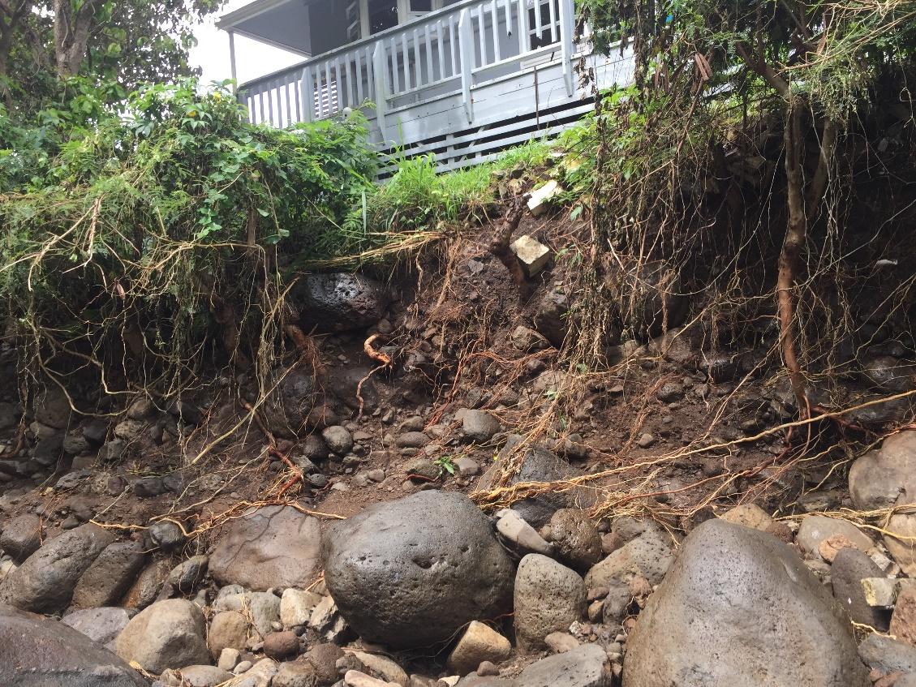
Between Hind Drive Bridge and Ani St. Bridge – After Storm
Looking downstream at Hao Place

Slide 10
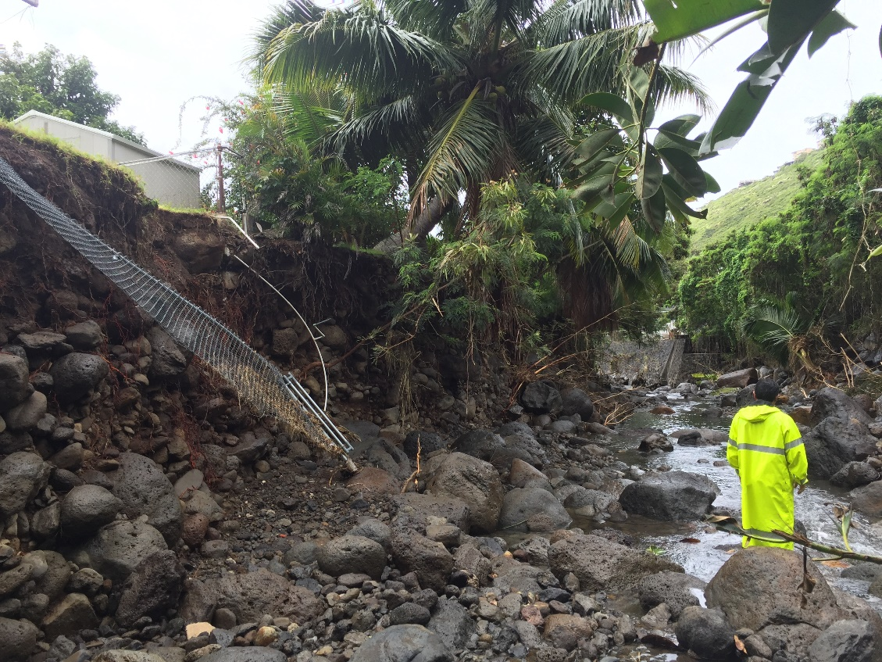
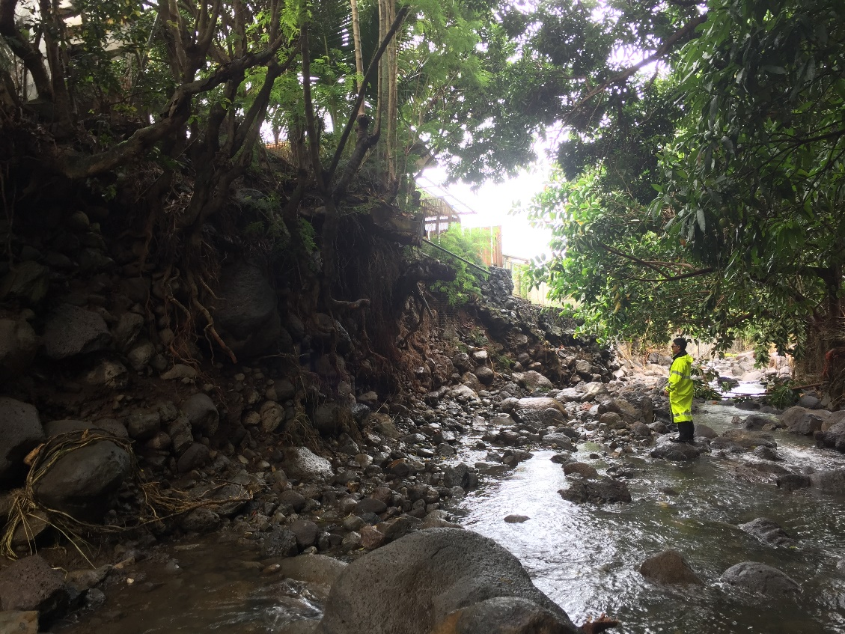
Between Hind Drive Bridge and Ani St. Bridge – After Storm
Looking downstream, 10-11 properties from Ani St. Bridge
Looking downstream 11-12 properties from Ani St. Bridge

Slide 11
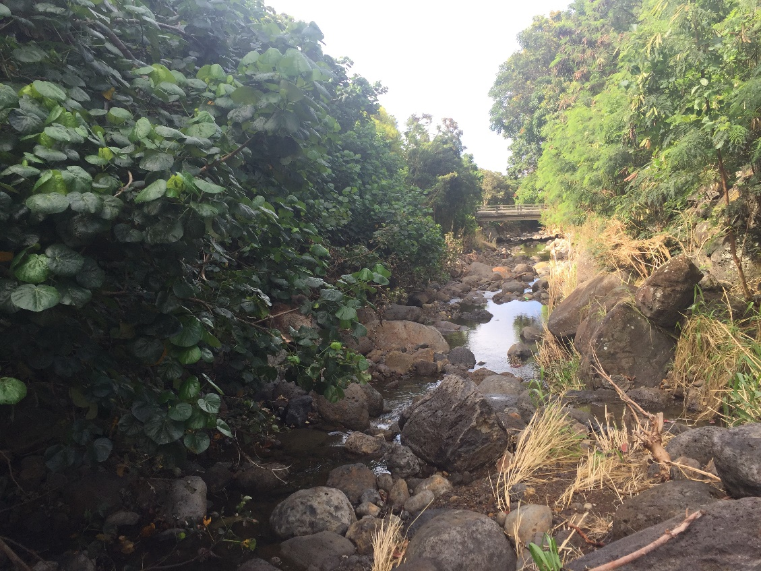
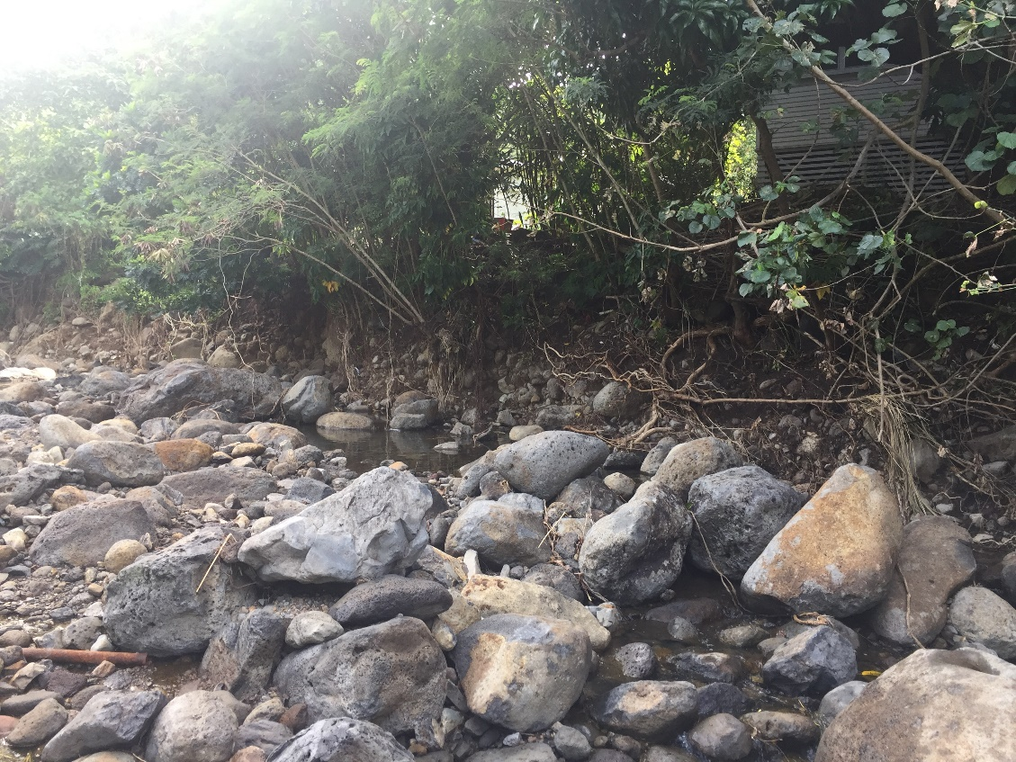
Between Ani St. Bridge and Debris Basin – After Storm
Looking downstream at Ani St. Bridge
6-7 properties upstream of Ani St. Bridge

Slide 12
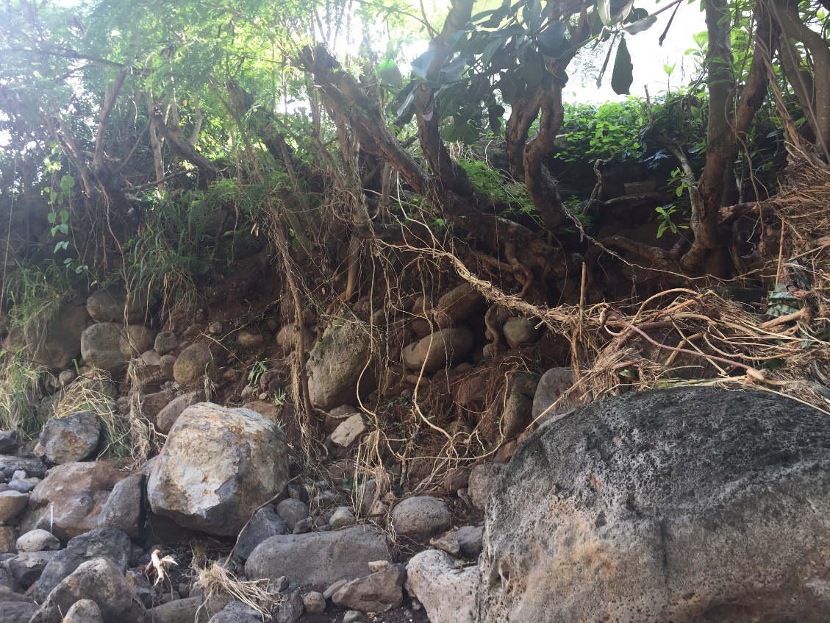
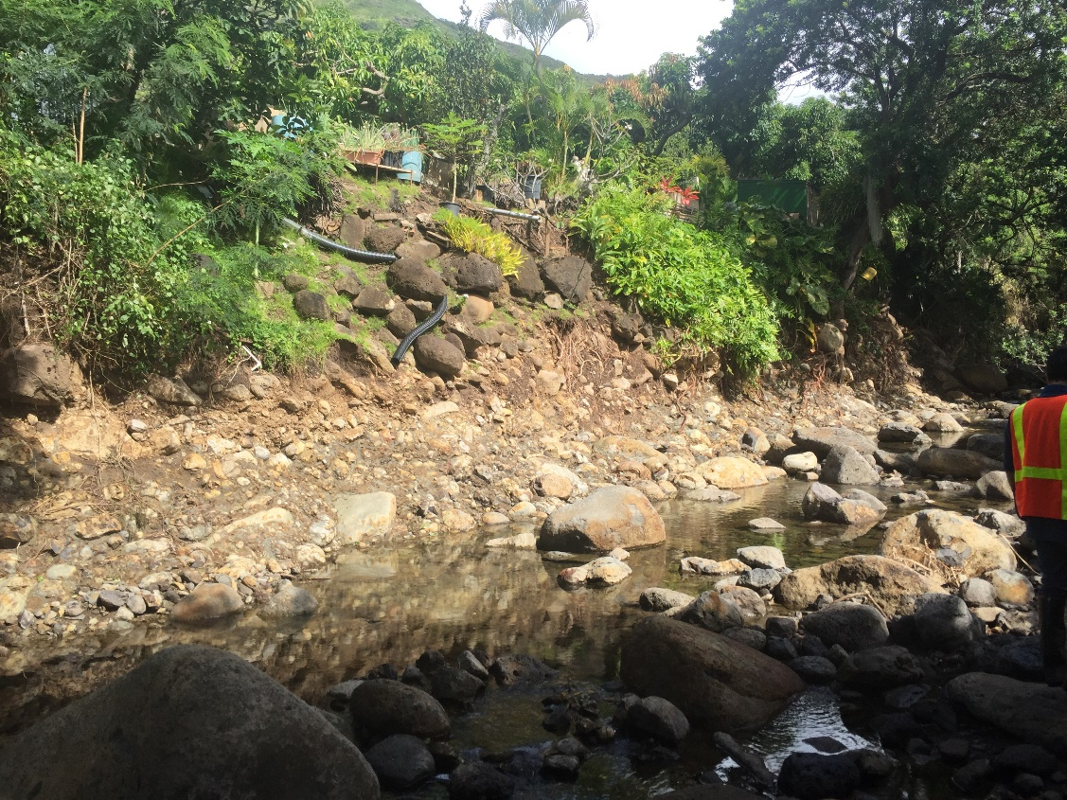
Between Ani St. Bridge and Debris Basin – After Storm
Looking upstream, 10-11 properties upstream of Ani St. Bridge
Looking downstream, 12-13 properties upstream of Ani St. Bridge

Slide 13
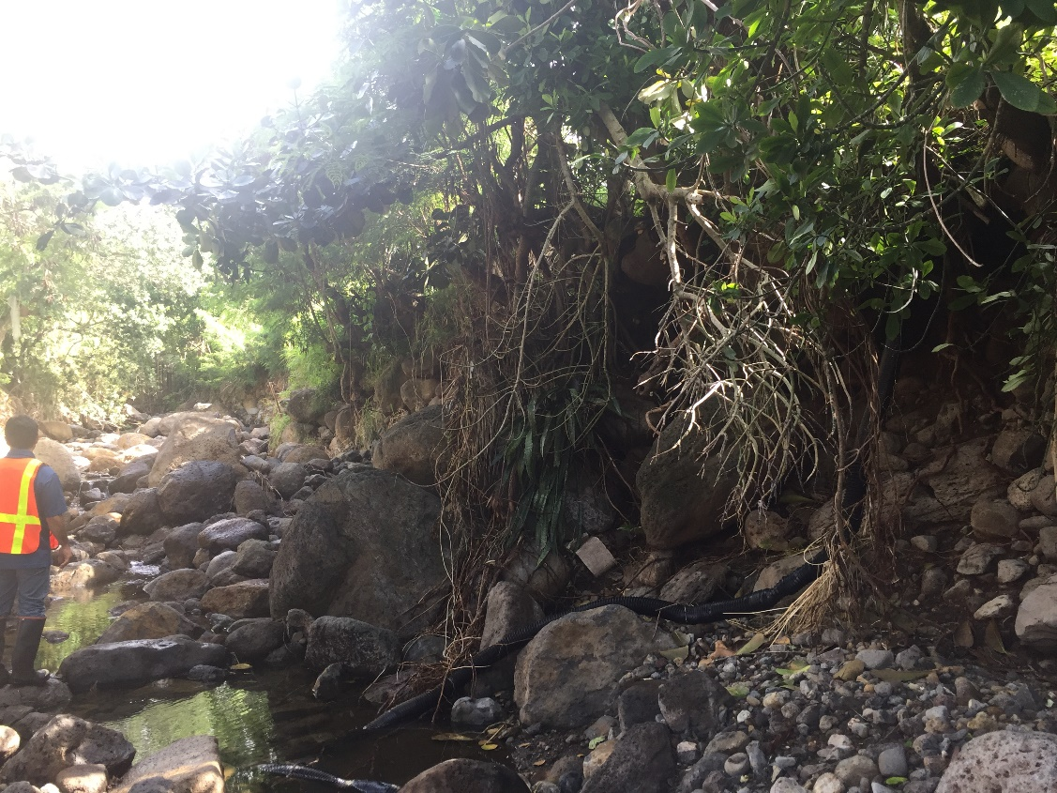
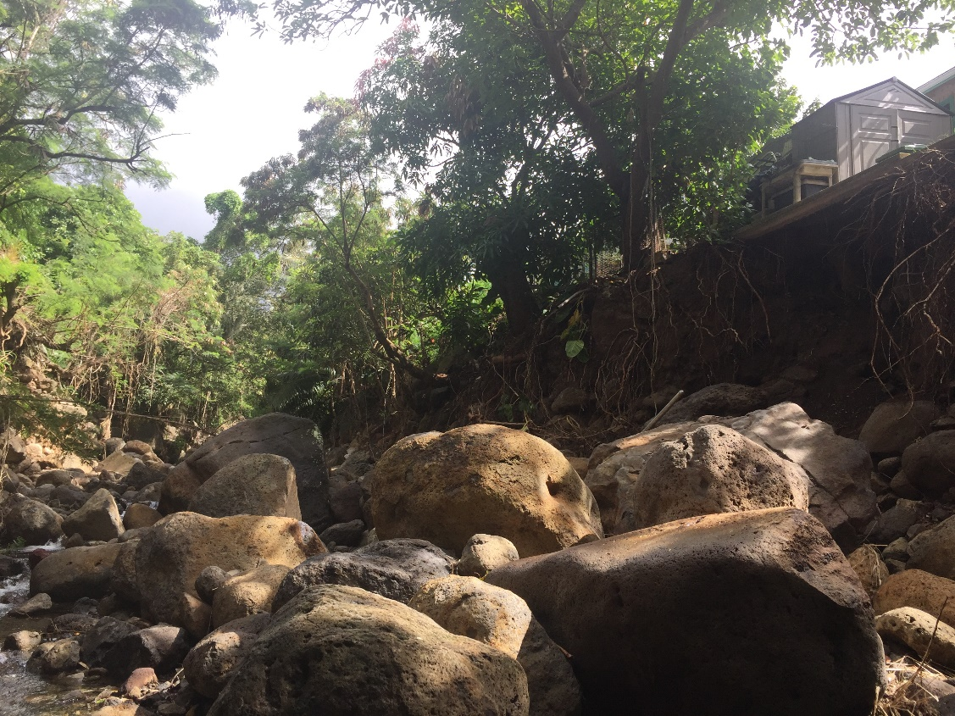
Between Ani St. Bridge and Debris Basin – After Storm
Looking upstream, bend at 8-9 properties upstream of Ani St. Bridge
Looking upstream, 13-14 properties upstream of Ani St. Bridge

Slide 14
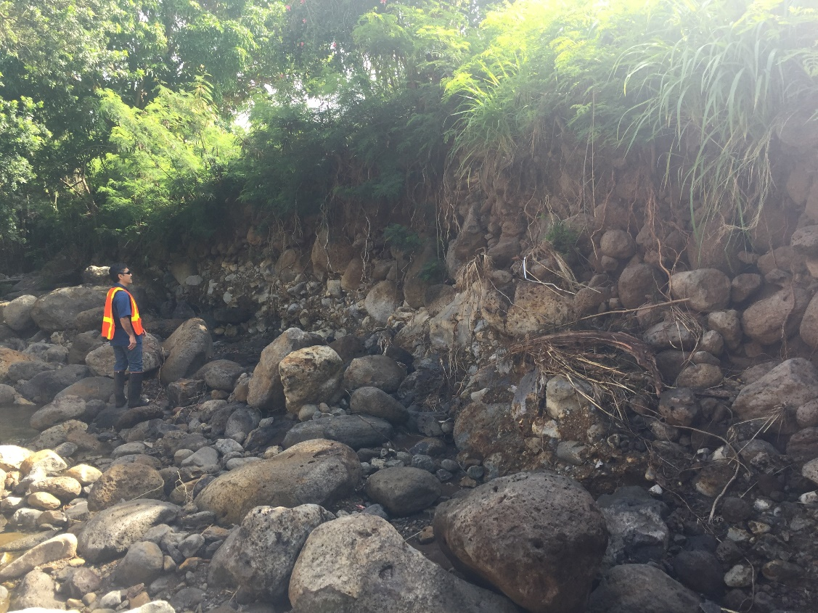
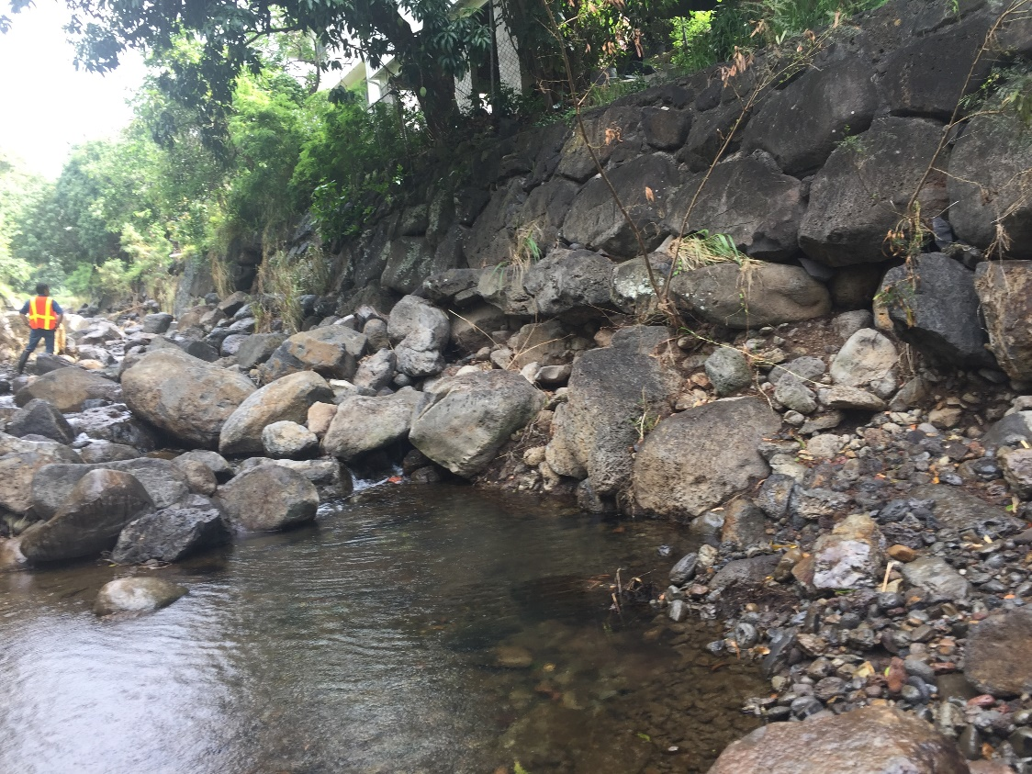
Between Ani St. Bridge and Debris Basin – After Storm
Looking upstream, 15-16 properties upstream of Ani St. Bridge
Looking upstream, 12-13 properties from boulder basin

Slide 15
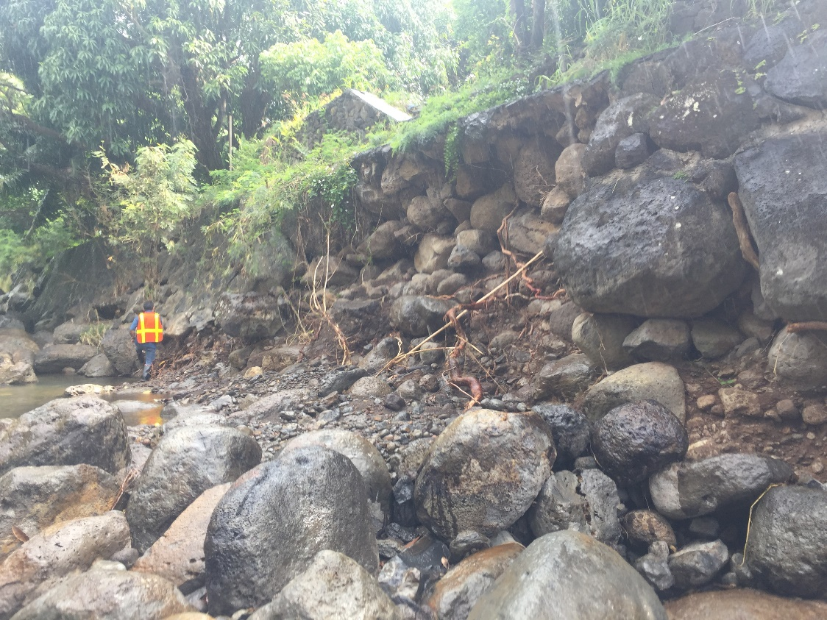
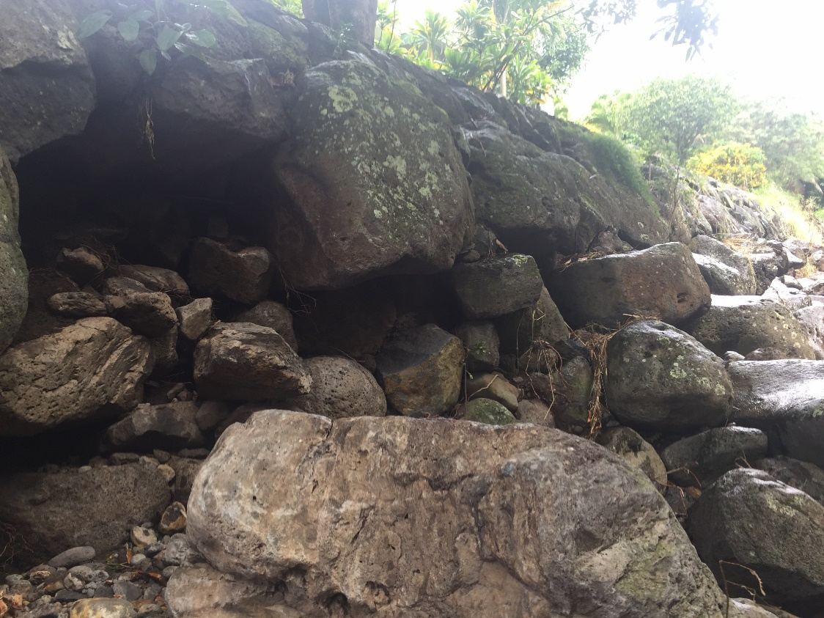
Between Ani St. Bridge and Debris Basin – After Storm
Looking downstream, 8-9 properties downstream of boulder basin
Looking upstream, 6-7 properties downstream of boulder basin

Slide 16
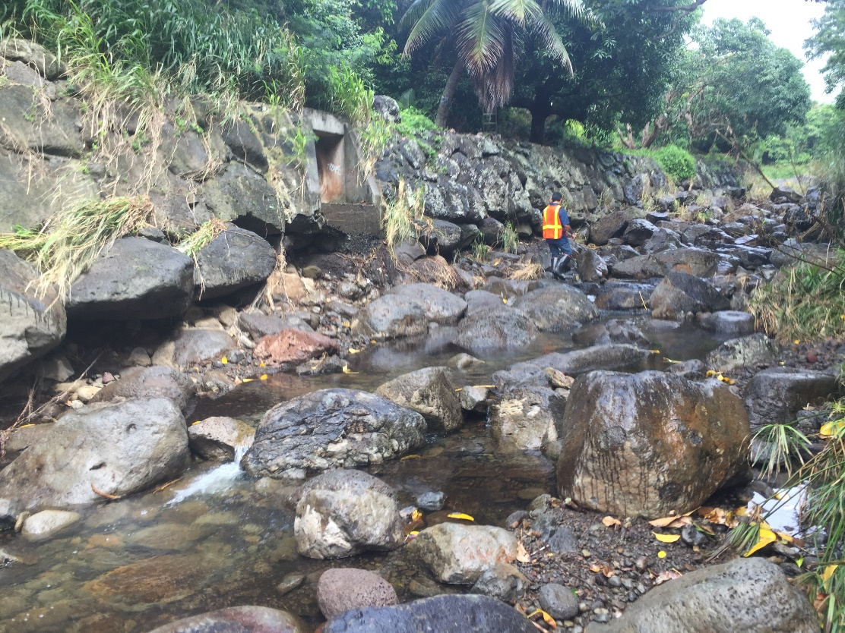
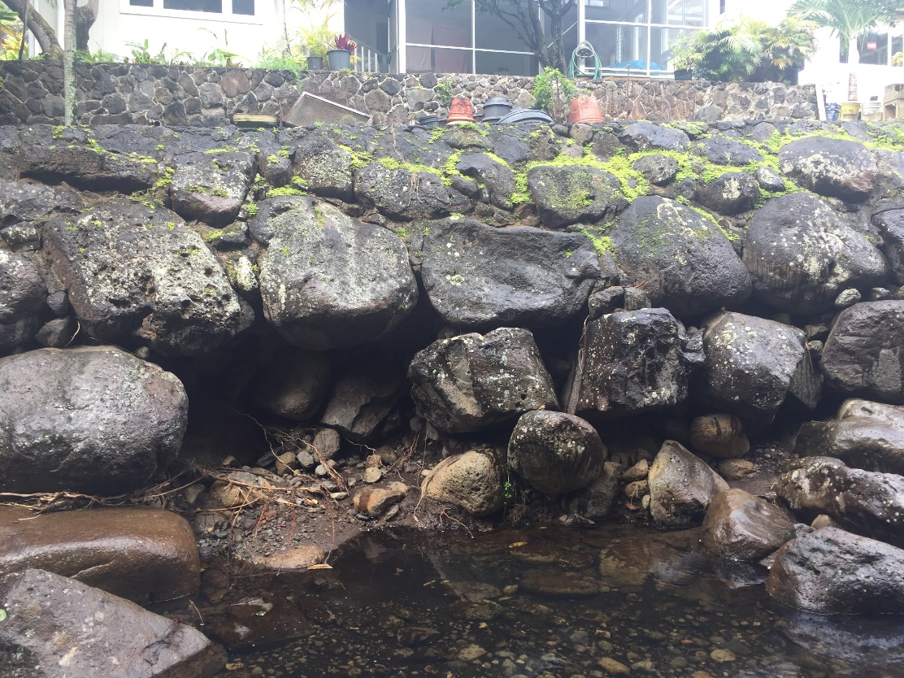
Between Ani St. Bridge and Debris Basin – After Storm
Looking upstream, 4-5 properties downstream of boulder basin
Looking upstream, 3-4 properties downstream of boulder basin

Slide 17
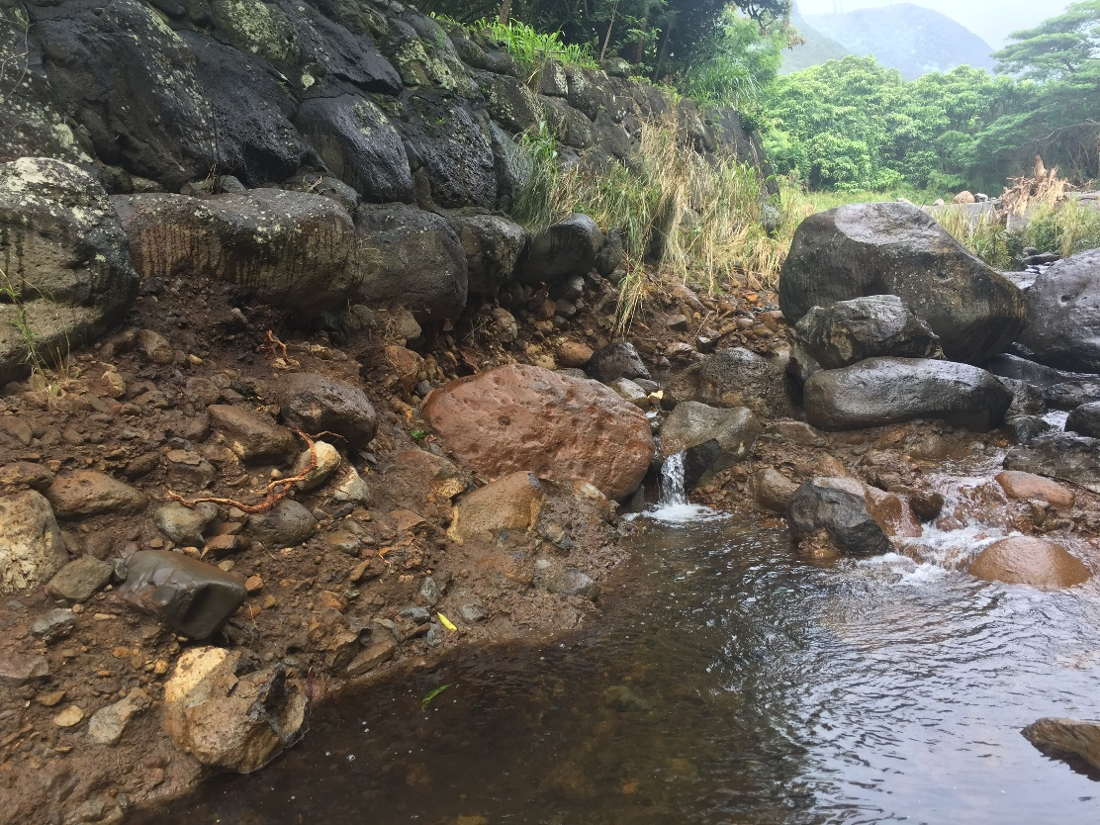
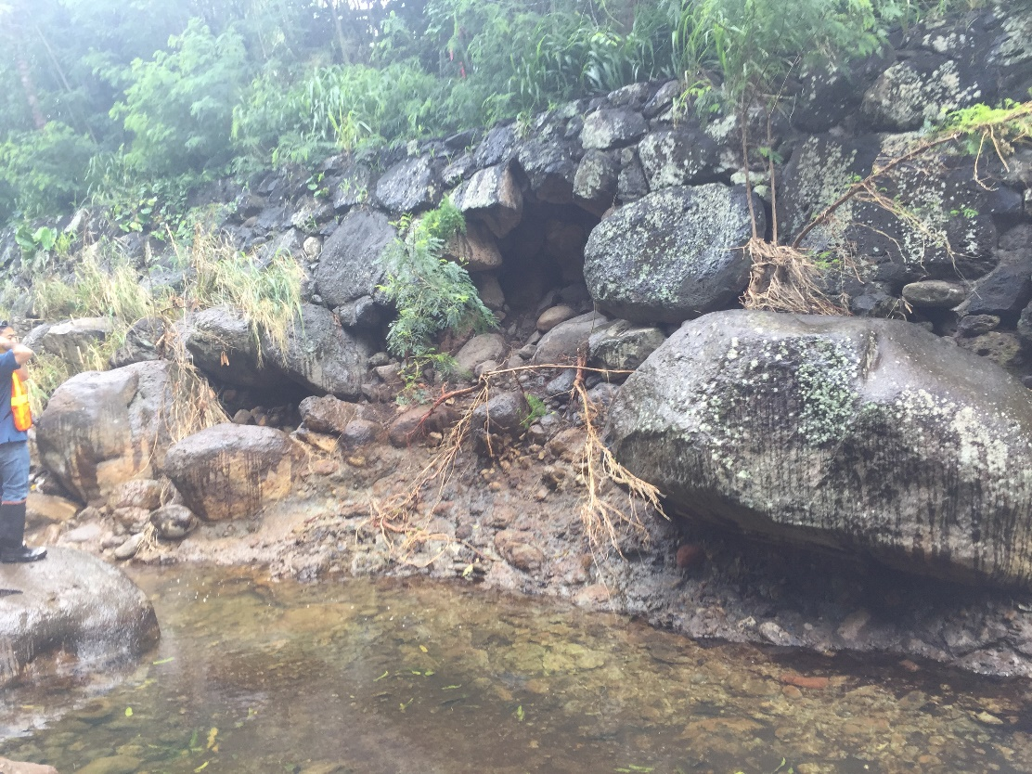
Between Ani St. Bridge and Debris Basin – After Storm
Looking upstream, 2-3 properties downstream of boulder basin

Slide 18
Emergency Repairs Project for Wailupe Stream
Consultant: Sato and Associates, Inc.
Contractor: Royal Contracting Co. Ltd.
Scope: To restore the stream section, to as close as possible, to it’s as- built condition. The original stream section consisted of stacked boulders along the stream banks. This project cleared the middle of the stream of boulders to provide clear flow area and channel the flow towards the center of the stream between the Hind Drive Bridge and boulder basin approximately 5,400 feet. Boulders that are cleared from the center of the stream was stacked along the stream banks to restore the channel section and also provide stabilization of the banks. The project also reconstructed a damaged portion of 18- inch drainpipe outlet and headwall at the mauka boundary of 646 Lawelawe Street property.

Slide 19
Project Plan

Slide 20
Project Plan – Stream bank Repair Details

Slide 21
Project Plan – Typical Grout Detail

Slide 22
After Emergency Project Repairs
Between Hind Drive Bridge and Ani St. Bridge
Between Ani St. Bridge and Debris Basin

Slide 23
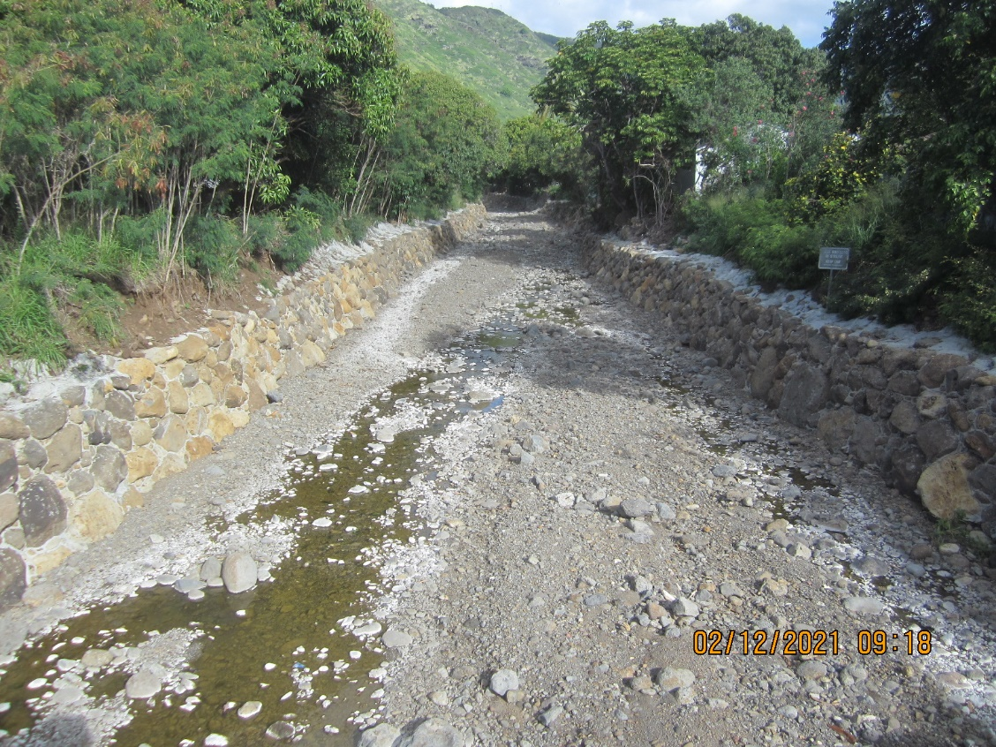
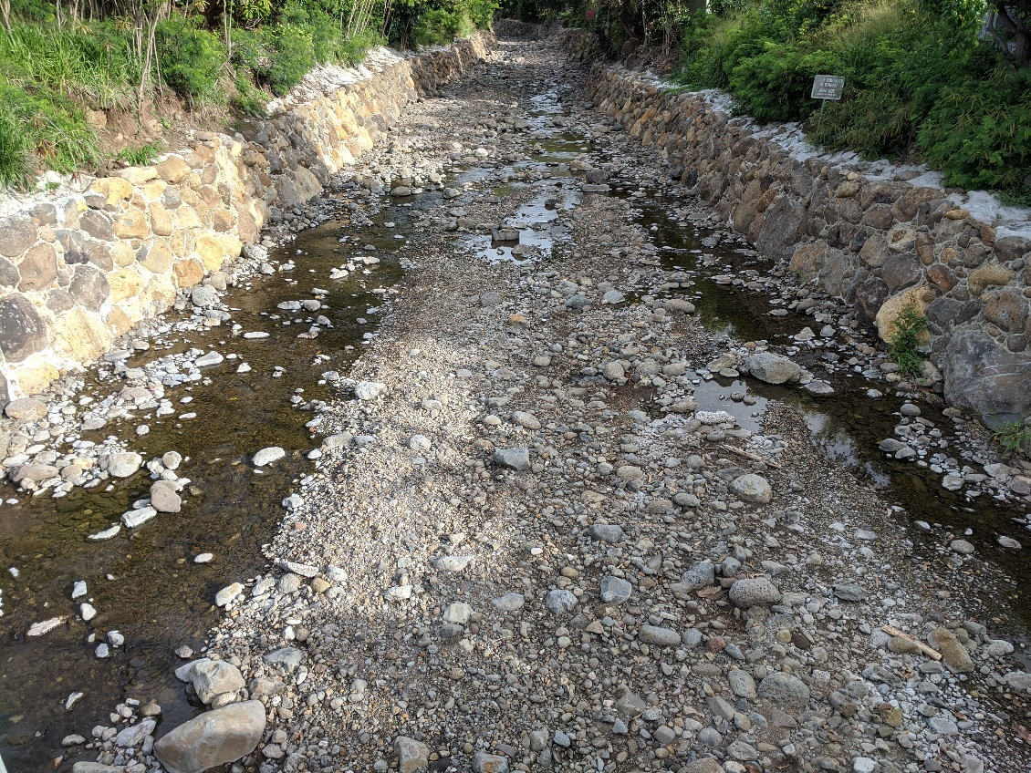
Between Hind Drive Bridge and Ani St. Bridge – After Project
Looking upstream from Hind Dr. Bridge

Slide 24
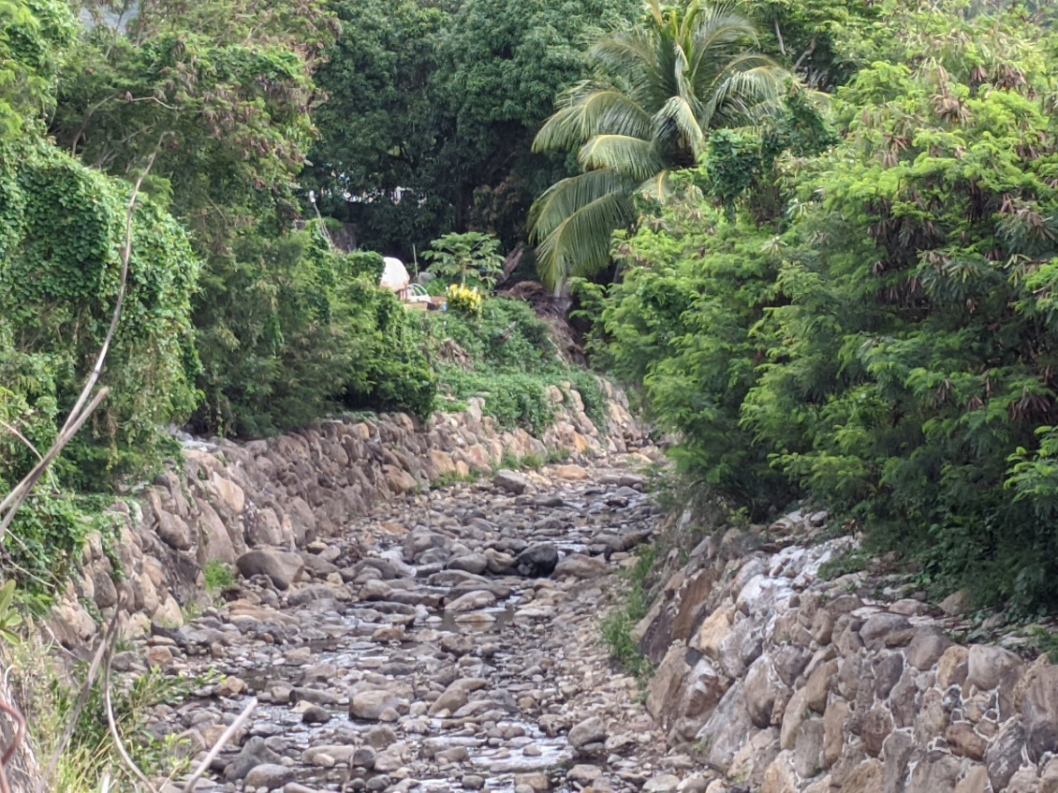
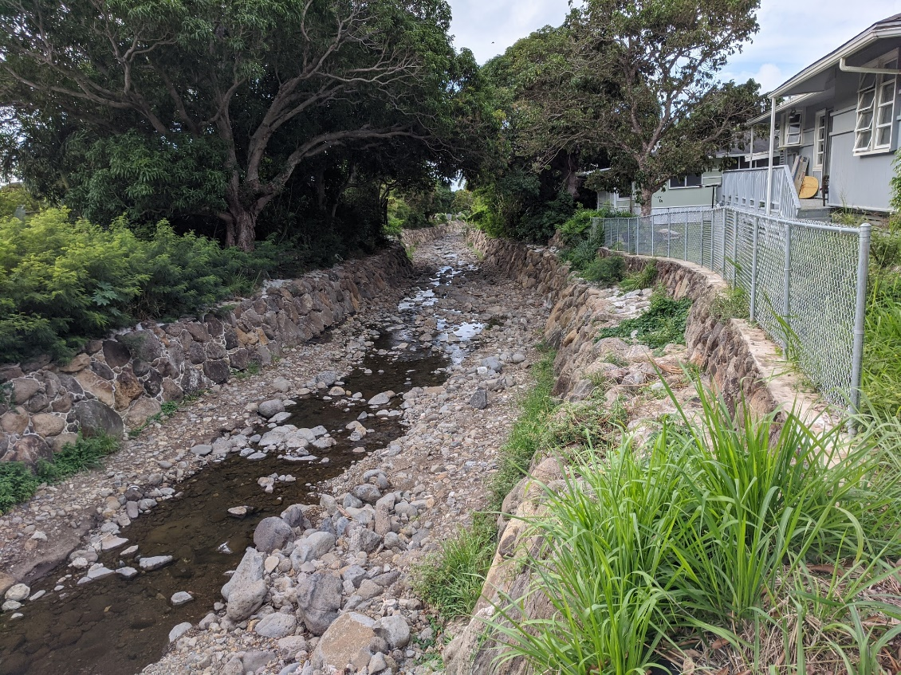
Between Hind Drive Bridge and Ani St. Bridge – After Project
Looking upstream at bend from Hind Dr. Bridge
Looking downstream from Hao Pl

Slide 25
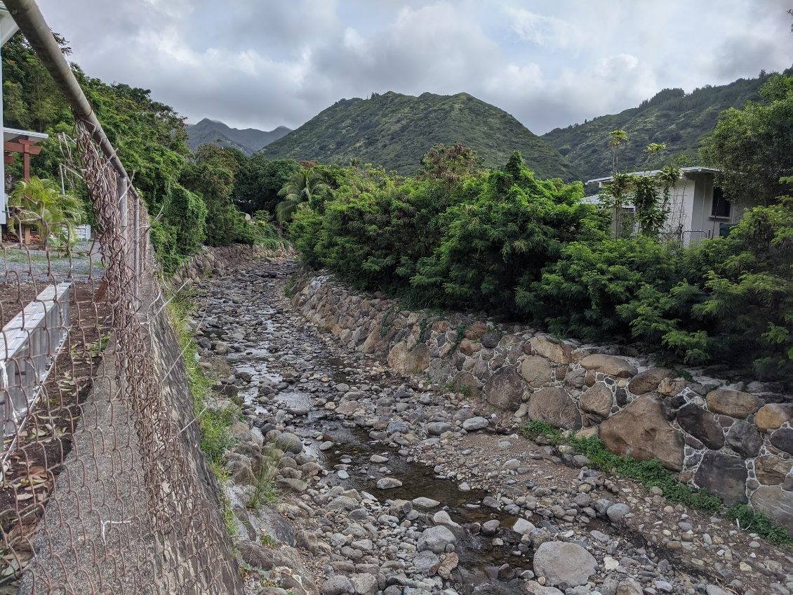
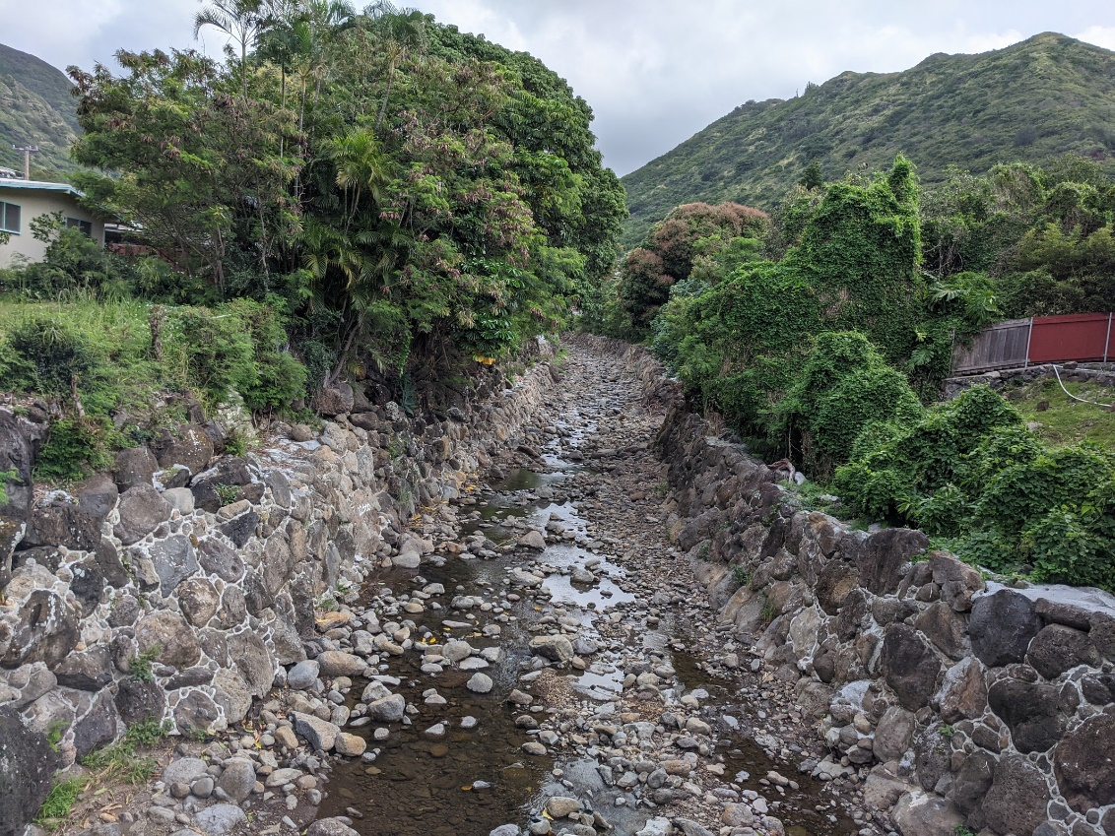
Between Hind Drive Bridge and Ani St. Bridge – After Project
Looking upstream from Hao Pl.
Looking upstream from Ani Bridge to bend

Slide 26
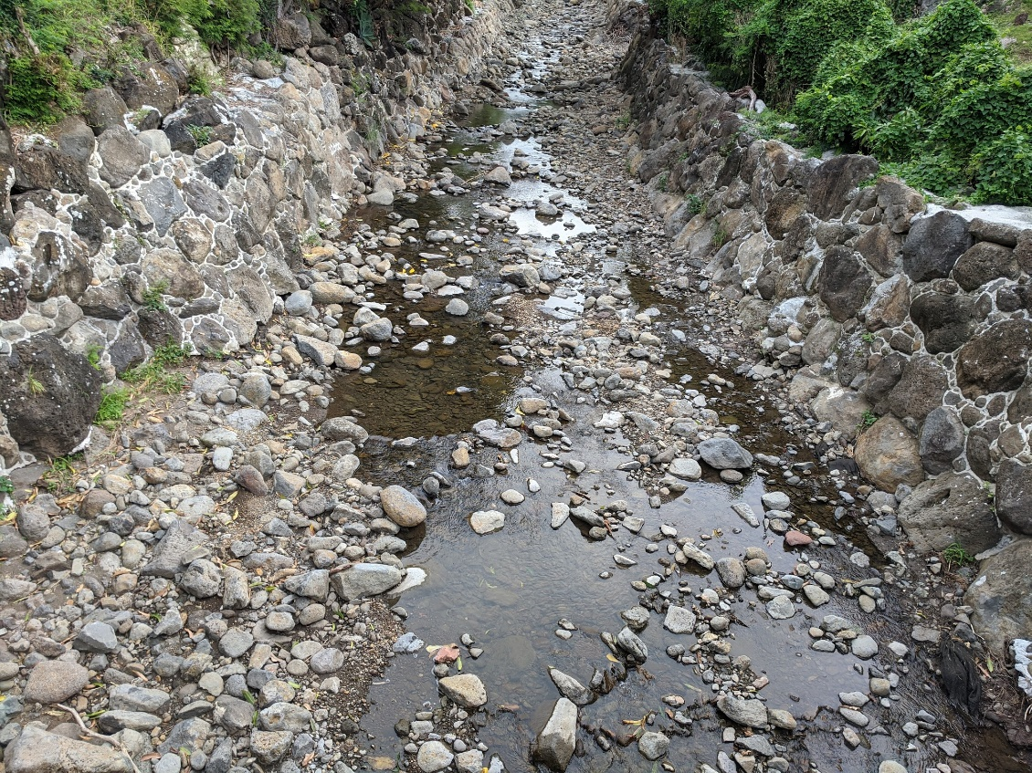
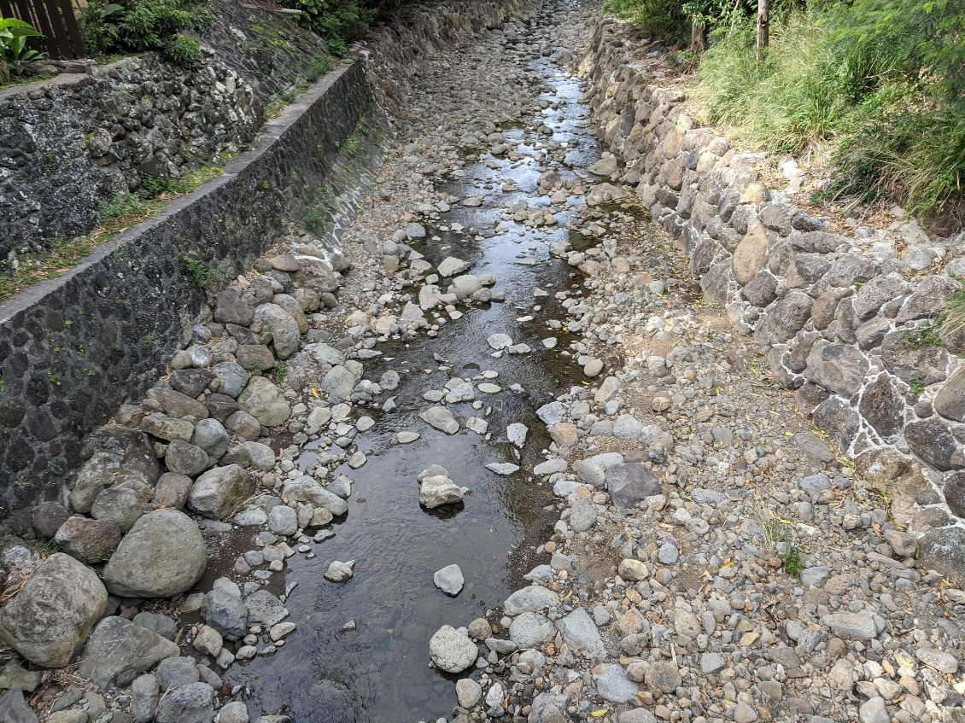
Between Hind Drive Bridge and Ani St. Bridge – After Project
Looking upstream from Ani St. Bridge
Looking downstream from Ani St. Bridge

Slide 27
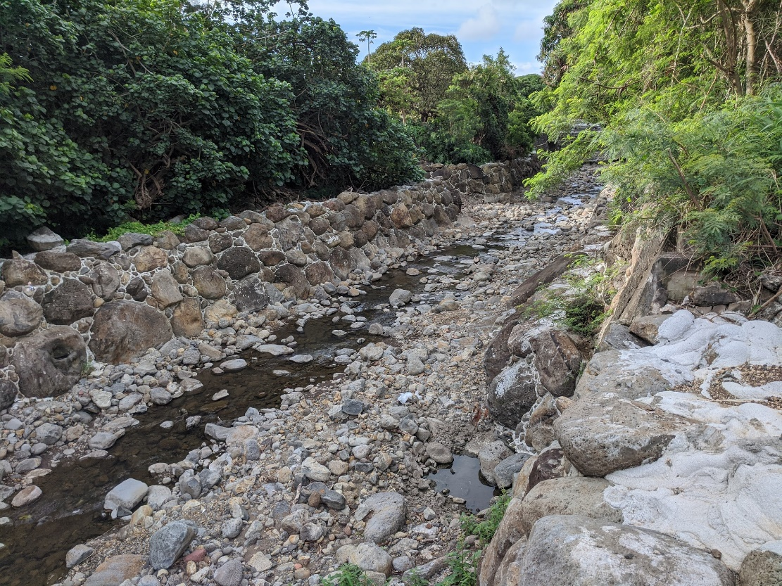
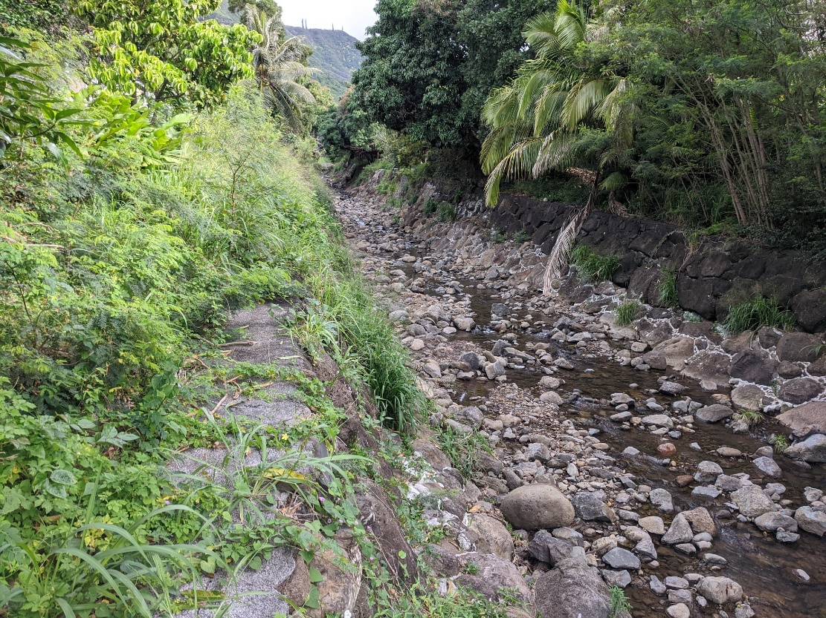
Between Ani St. Bridge and Debris Basin – After Project
Looking downstream, from Hao St. access
Looking upstream, from Hao St. access

Slide 28
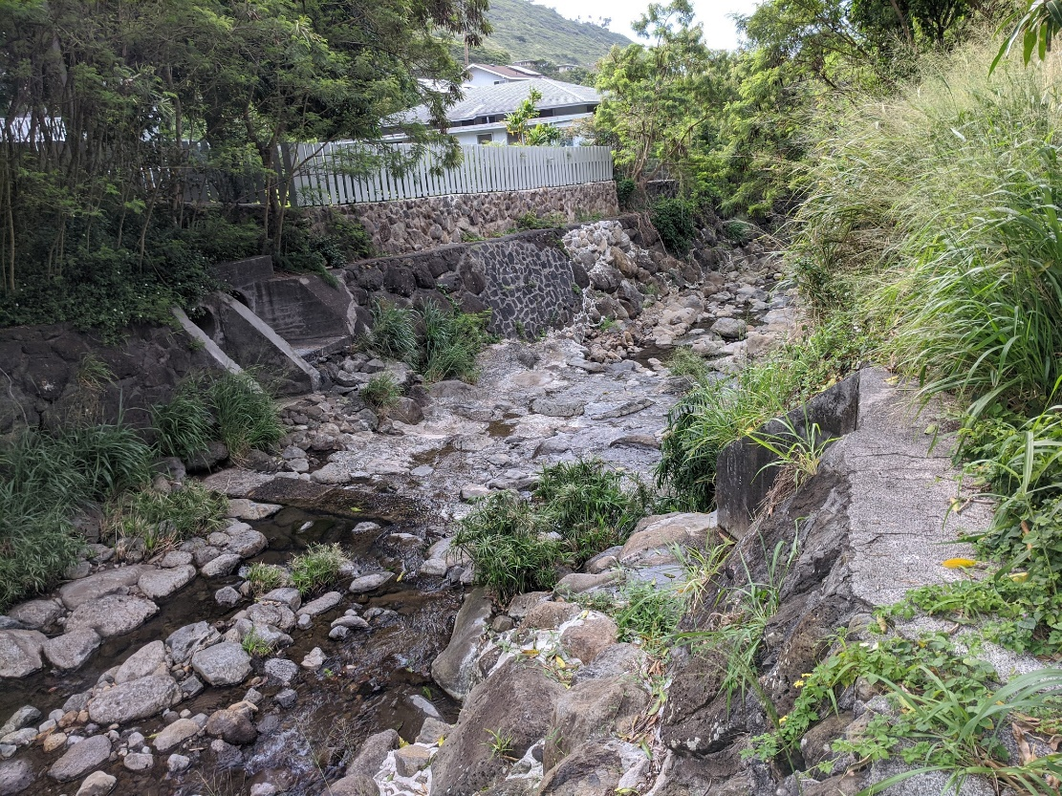
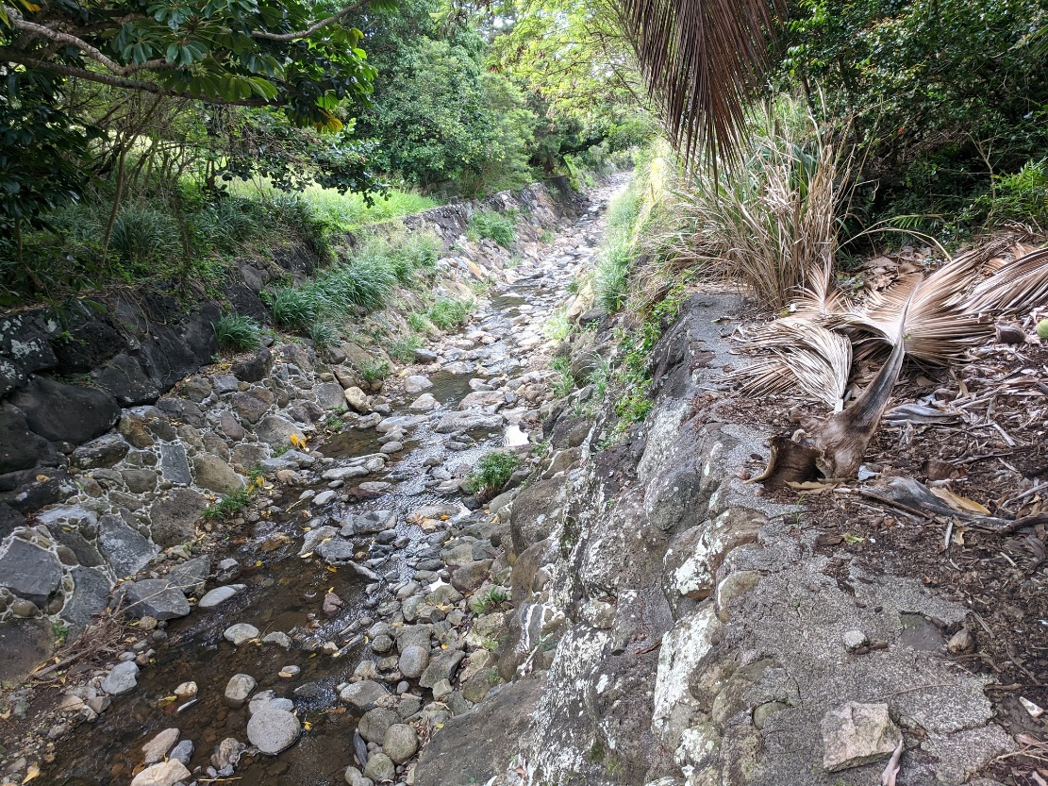
Between Ani St. Bridge and Debris Basin – After Project
Looking upstream from Hao St. access
Looking downstream from third Hao St. access

Slide 29
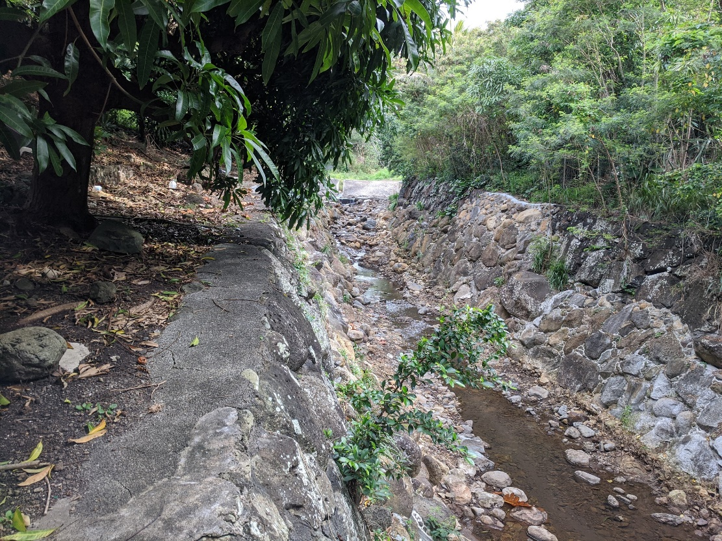
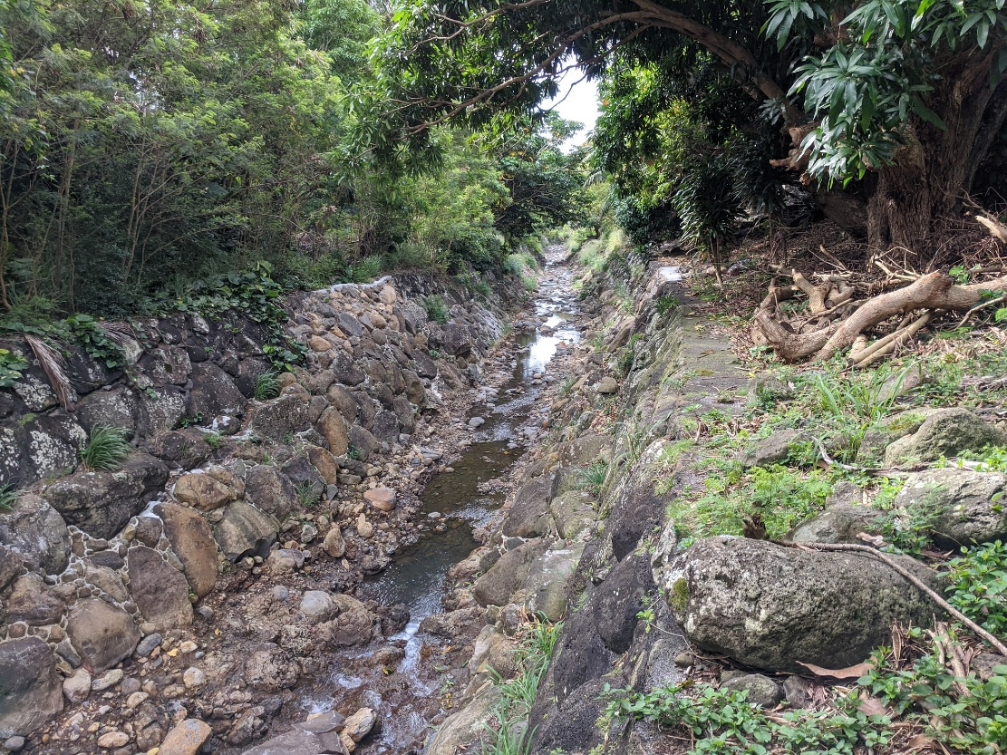
Between Ani St. Bridge and Debris Basin – After Project
Looking upstream from third Hao St. access
Looking downstream from boulder basin

Slide 30
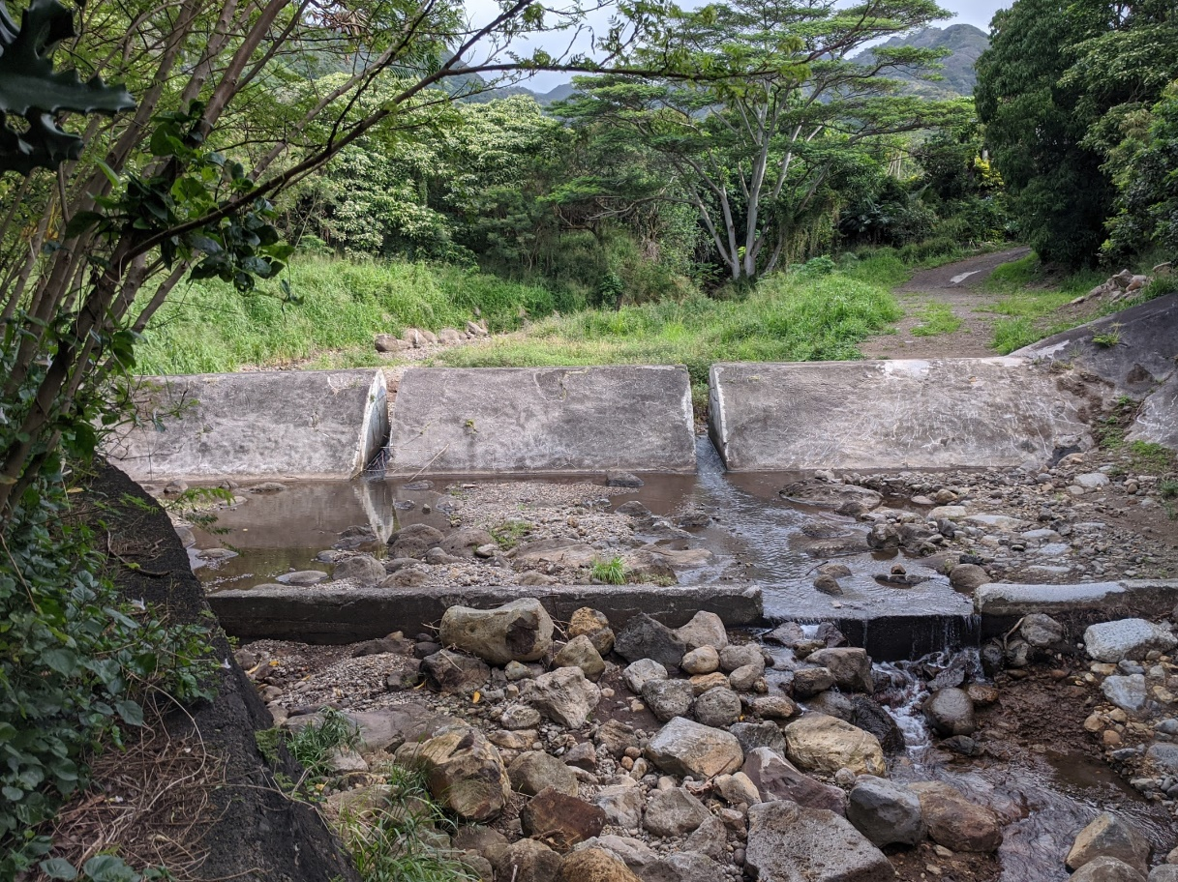
Between Ani St. Bridge and Debris Basin – After Project
Looking upstream at boulder basin

Slide 31
Questions?

Slide 32
Next Steps/Follow Up
Assistance with Army Corps of Engineers Small Cap program.
In the interim, the City will monitor the stream and provide small City projects within Wailupe Stream, if needed.

