Slide 1
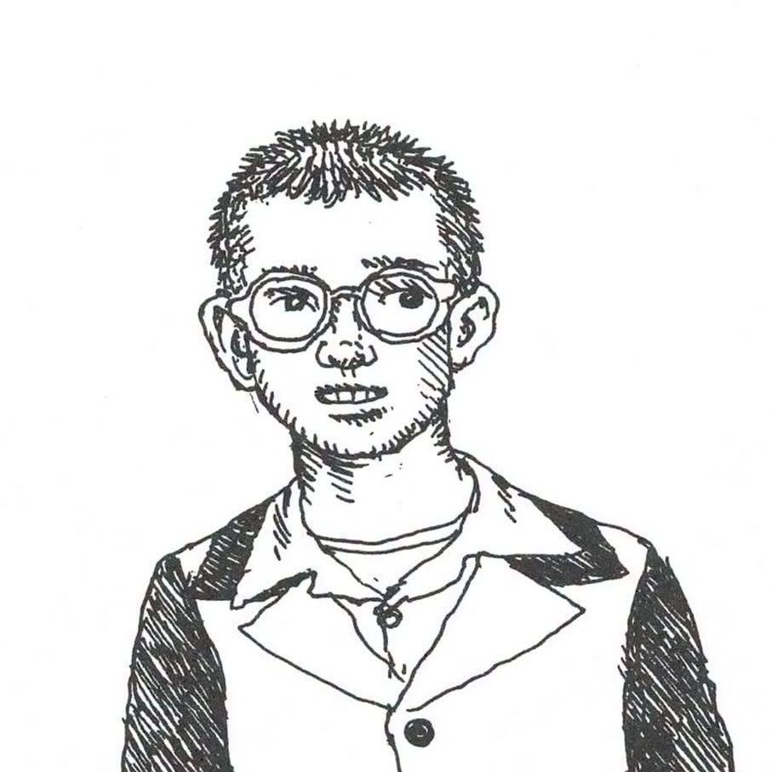
On Robert Crumb’s Genesis
By Alex Ly and Rick Wagner
Notes:
Robert Crumb self-portrait, 1953.

Slide 2
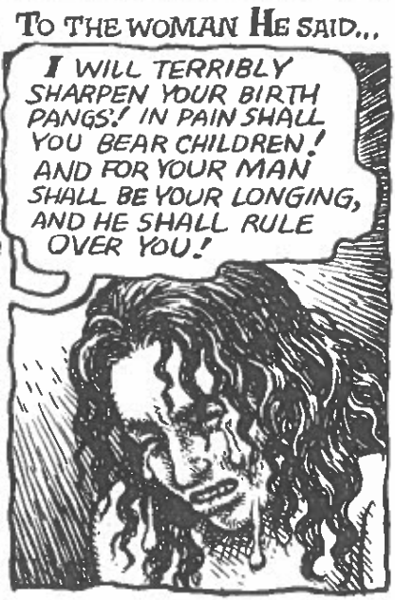
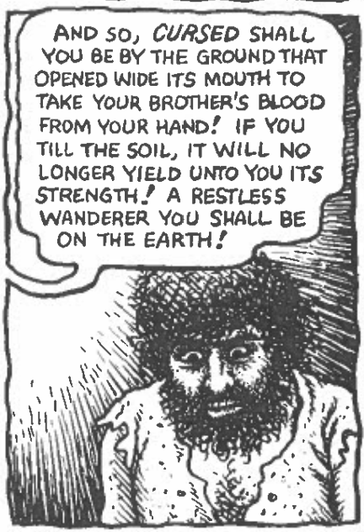
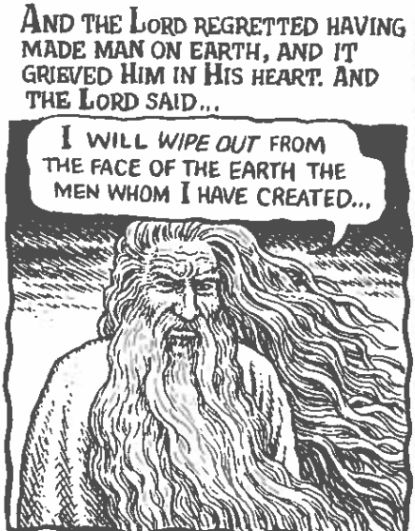
Arguments about the text
Robert Crumb’s portrayal of God throughout his illustration of the Book of Genesis shows that God is not a benevolent or kind God, but a ruthless and unforgiving God.
Notes:
What is “bad” or peculiar about the style (the how of the telling)? Make assertions that are not obvious but will be controversial.

Slide 3
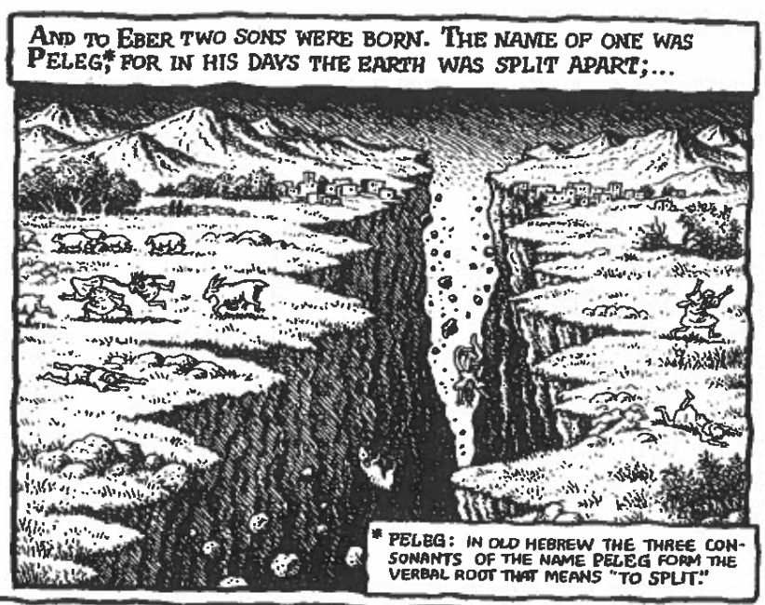
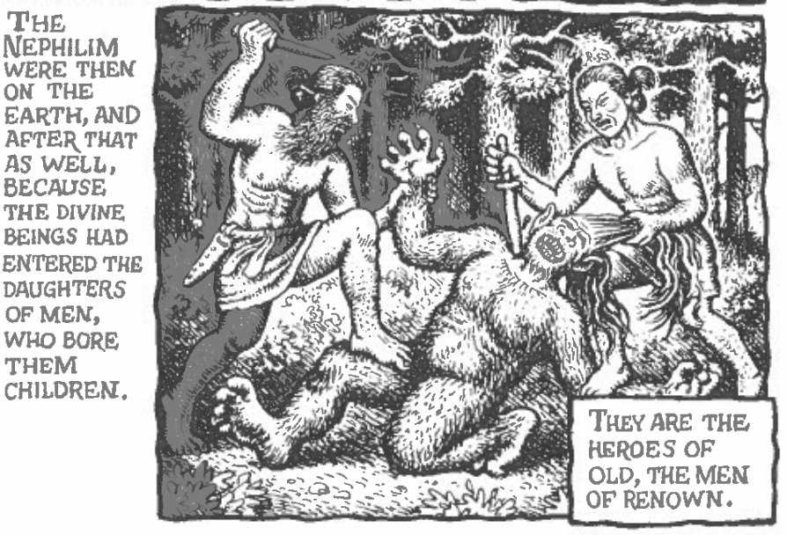
Arguments about the text
The vagueness of the original Book of Genesis served to support the ideals of Christianity which are undone by Crumb’s illustrations which show the true strangeness and absurdity.
Notes:
What is “bad” or peculiar about the style (the how of the telling)? Make assertions that are not obvious but will be controversial.

Slide 4
Main Points of Genesis
God: Wanted to withhold knowledge from Adam & Eve, enacts cruel tests of faith onto his followers, shortening of man’s lifespan, annihilation of evil by wiping out man
Noah: God’s murder of the entire world including animals except for Noah’s family and gathered animal pairs
Abraham: a cruel and inhuman test of blind obedience/devotion
Notes:
Outline main points. What action, emotion, or effect, makes you feel (something) about the literary canon?

Slide 5
Main Outline
“Straight Illustration”
Crumb intended to illustrate it as a faithful reproduction of the Book of Genesis
Comic form deprives the reader of imagery interpreted from the text
Vagueness of the text leaves room for interpretation
Crumb’s Interpretation
Crumb’s agnostic views still bleed through his illustrations
Vagueness unblurred by Crumb’s illustrations
Illustrations don’t portray the Book of Genesis in a good light
Notes:
Outline main points. What action, emotion, or effect, makes you feel (something) about the literary canon?

Slide 6
How of the telling
Illustrations expand upon the vagueness of Genesis in the author’s interpretation
  Genesis 6: Depictions of “evil” as pagans, specifically Aztecs and vikings despite the text not clearly defining the “evil”.
  Genesis 22: Depiction of Abraham shows him as fully prepared to sacrifice Isaac, without remorse or fear in his eyes. The only fear comes when God calls out to him.
Illustrations also serve to reach a wider audience

Slide 7
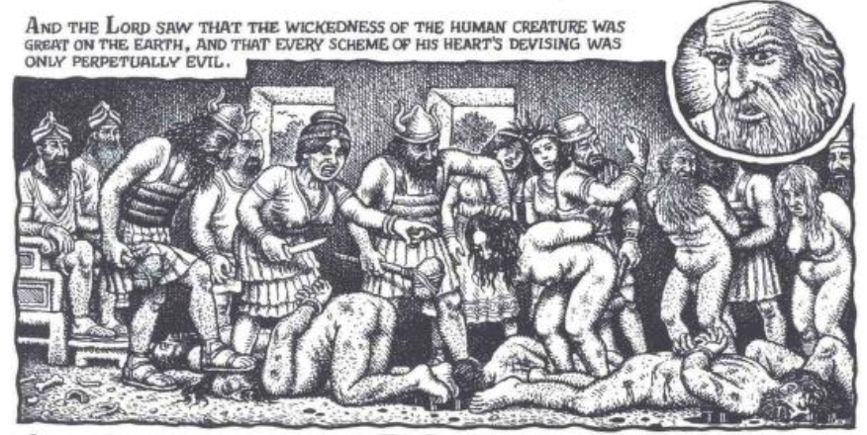
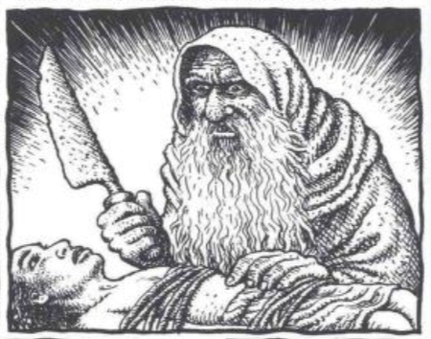
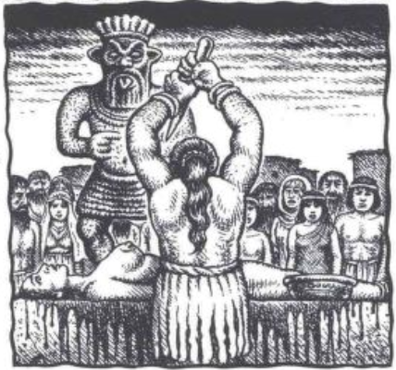
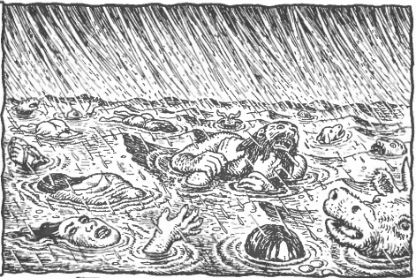

Slide 8
Gods Comparison: Genesis vs. Gilgamesh
King
Enlil
God
Son
Sky
Sea
Moon
Anu
Ea
Sin
Daughter
Sun
Son
Messenger
Nisun
Shamash
Sex and war
Underworld
Ishtar
Ereshkigal
Namtar
Human
Minister

Slide 9
Three Questions for classmates
Question one
  Does Robert Crumb’s illustration serve as a faithful depiction of the Book of Genesis or as a critique of the Book of Genesis?
Question two
  Did Noah's displeasure with Canaan and his resulting statements mean that God condoned or approved of slavery?
Question three
  Did God change the laws of optical physics so that there were rainbows only after the post-flood covenant or does this further prove the absurdity of God’s powers?
Notes:
Several questions present themselves. We list them and discuss on the following pages.

Slide 10

Half an hour to write prompts

