Slide 1
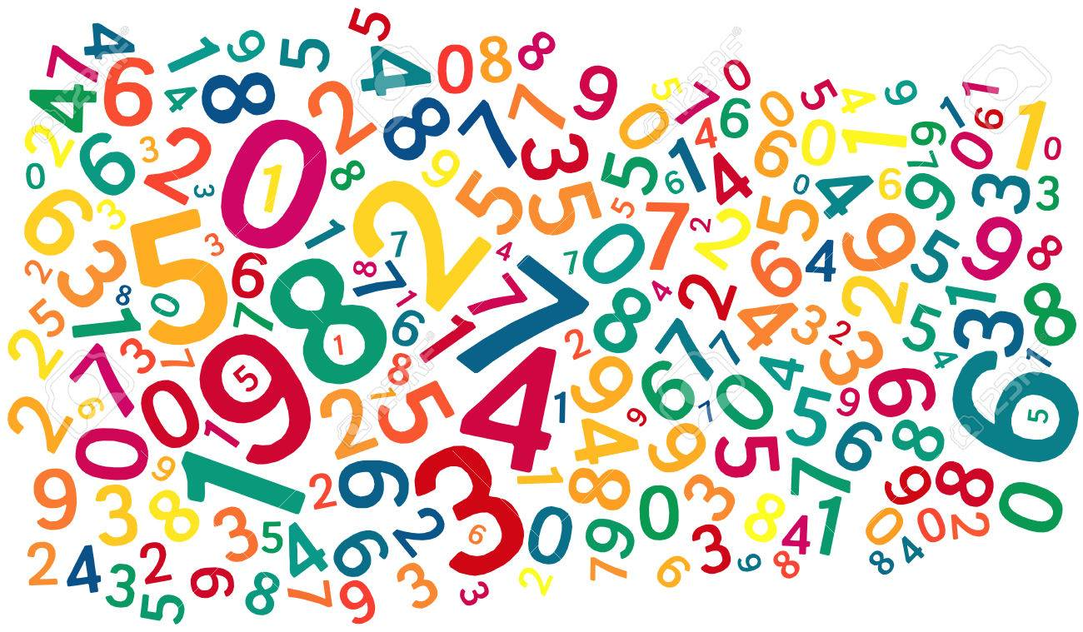
Numbers in Hawaiian
https://www.123rf.com/photo_25975056_word-cloud-background-composed-out-of-numbers.html

Slide 2
1 ʻekahi 6 ʻeono
2 ʻelua 7 ʻehiku
3 ʻekolu 8 ʻewalu
4 ʻehā 9 ʻeiwa
5 ʻelima 10 ʻumi

Slide 3
Numbers from 1-9 have that prefix ʻe. In writing, you will sometimes see a variant which starts with ʻa. For example, ʻakahi, ʻalua, ʻakolu, etc.
ʻewalu and ʻeiwa usually both use the “v” pronunciation.
The word for zero is ʻole.

Slide 4
Higher numbers
11 ʻumikūmākahi 16 ʻumikūmāono
12 ʻumikūmālua 17 ʻumikūmāhiku
13 ʻumikūmākolu 18 ʻumikūmāwalu
14 ʻumikūmāhā 19 ʻumikūmāiwa
15 ʻumikūmālima 20 iwakālua

